Slide 1
Transformers
CSCI 4360/6360 Data Science II

Slide 2
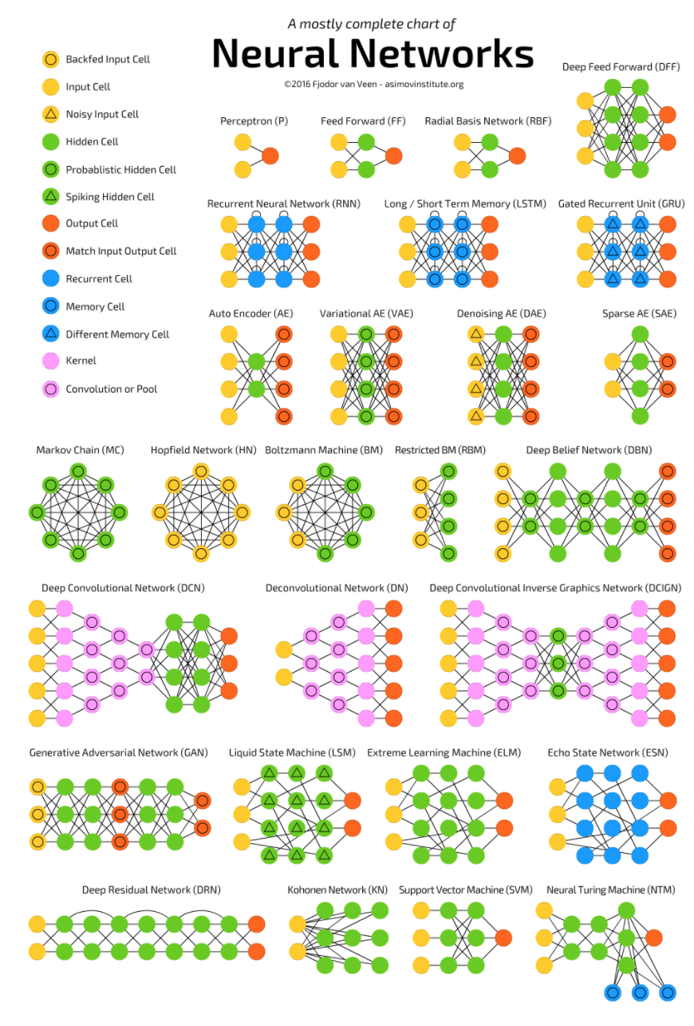
The Neural Network Zoo
http://www.asimovinstitute.org/neural-network-zoo/

Slide 3
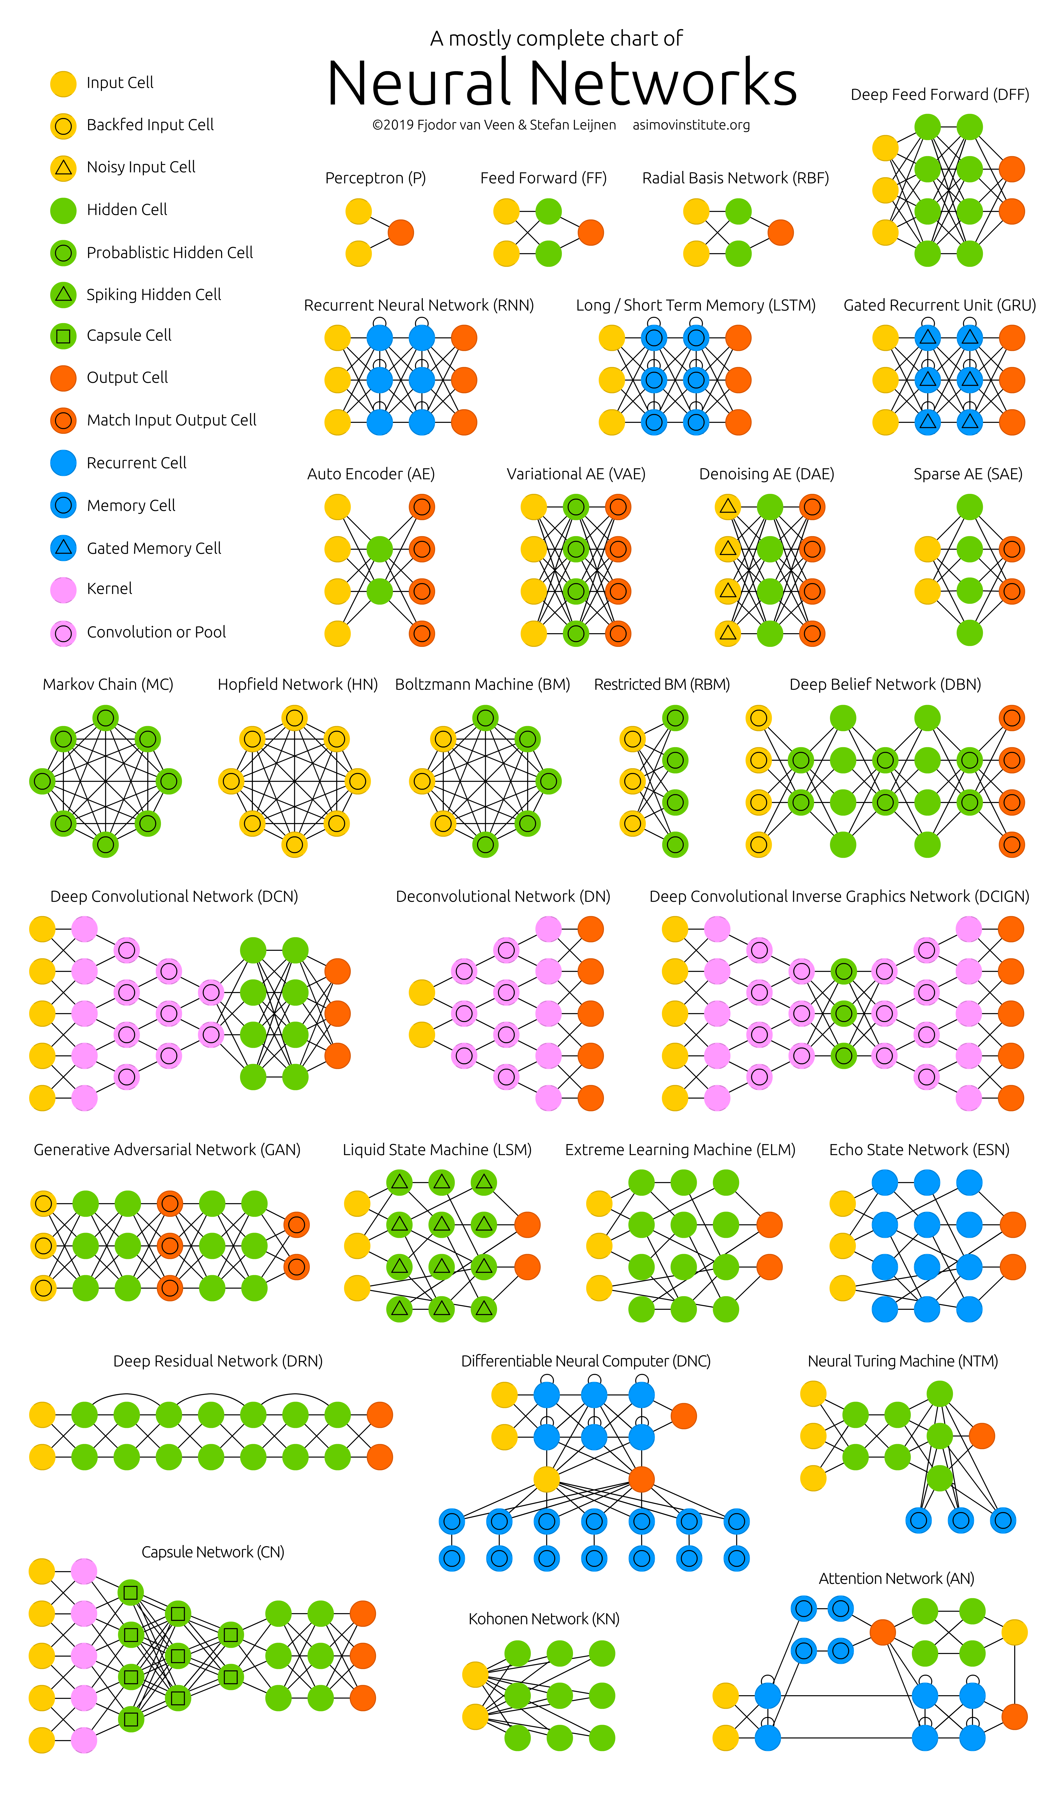
The Neural Network Zoo
http://www.asimovinstitute.org/neural-network-zoo/

Slide 4
The Neural Network Zoo
http://www.asimovinstitute.org/neural-network-zoo/
Today

Slide 5
Transformers
A confluence of multiple technologies and theories
Encoder-Decoder Networks
Attention
Parallelization

Slide 6
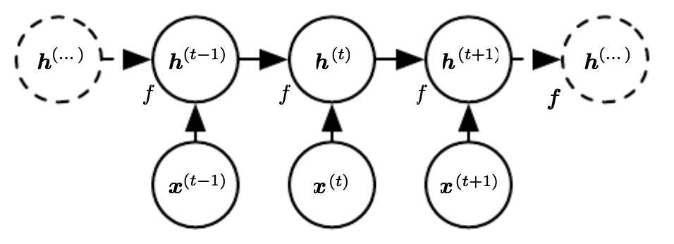
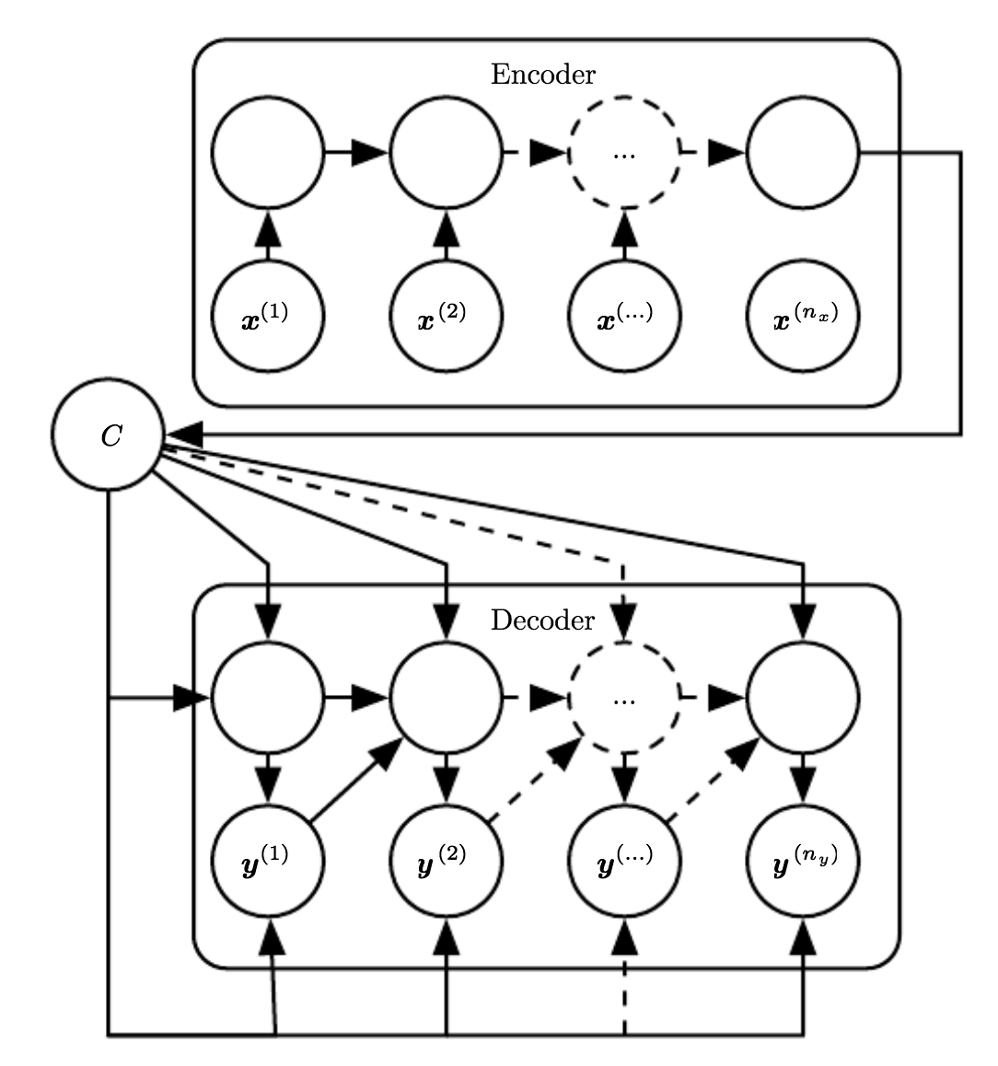
RNNs revisited
Recurrences
Input + hidden state
LSTM “forget” gate
Encoder-decoder
Sequential architecture precludes parallelization
Lot of information crammed into h_{t}
“Catastrophic forgetting”

Slide 7

Transformers
Transductive model
Relies entirely on self-attention mechanisms
No sequence-aligned RNNs or convolutions

Slide 8
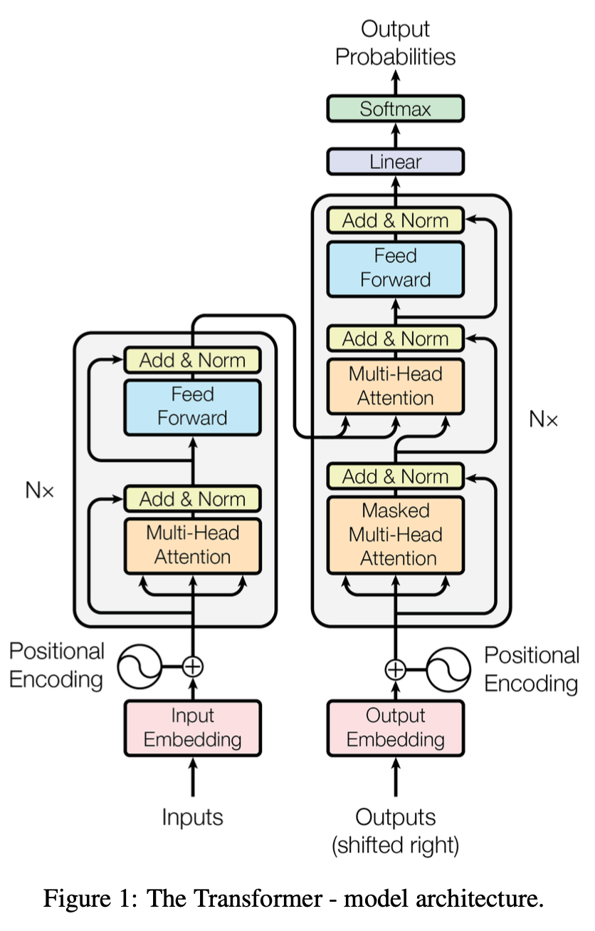
Transformer architecture
Encoder
Maps input sequence (x₁,...,x_{n}) to a representation sequence (z₁,…,z_{n})
Decoder
From sequence z, generates output sequence (y₁,…,y_{m})
Model is autoregressive
Stacked self-attention and point-wise fully connected layers
Positional encodings allow for fully parallelized encodings
Notes:
Encoder:
The encoder is composed of a stack of N = 6 identical layers. Each layer has two sub-layers. The first is a multi-head self-attention mechanism, and the second is a simple, position-wise fully connected feed-forward network. There’s a residual connection around each of the two sublayers, followed by layer norm.
Decoder:
The decoder is also composed of a stack of N = 6 identical layers. In addition to the two sub-layers in each encoder layer, the decoder inserts a third sub-layer, which performs multi-head attention over the output of the encoder stack. Similar to the encoder, there are residual connections around each of the sub-layers, followed by layer normalization. CRITICAL: Also some modifications to the self-attention sub-layer in the decoder stack to prevent positions from attending to *subsequent* positions. This masking, combined with fact that the output embeddings are offset by one position, ensures that the predictions for position i can depend only on the known outputs at positions less than i (no knowing the future!).

Slide 9
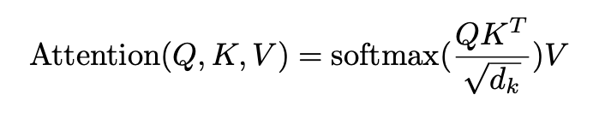
Attention
Maps:
A query
A set of key-value pairs
Query, Key, Value
An output
Weighted sum of values
Weight assigned to each value is output of a “compatibility function” of query with corresponding key
Vectors (in theory)
Matrices in practice (i.e., many queries/keys/values in parallel)

Slide 10
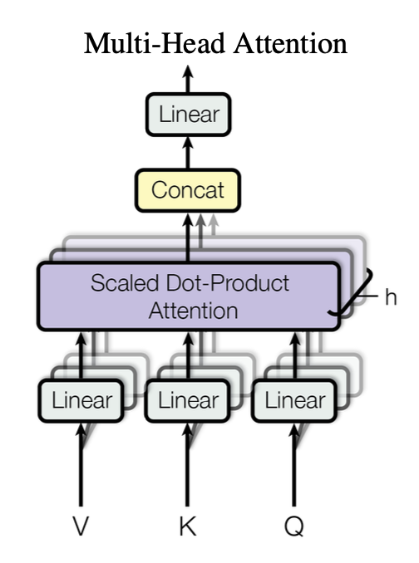
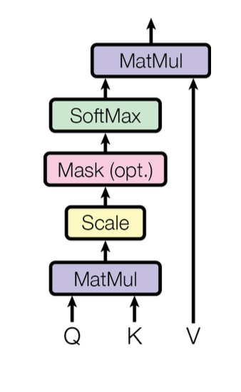
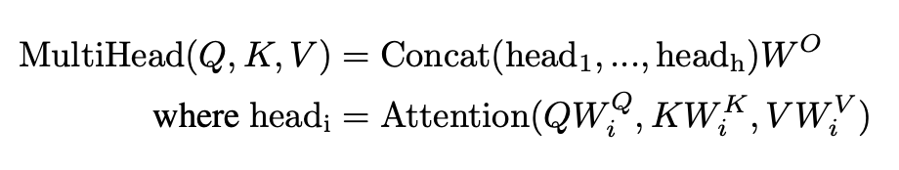
Attention
In 2017 paper, Attention = “Scaled Dot-Product Attention”
Multi-head attention
Linearly project Q, K, and V h times with different learned projections
Attention performed in parallel on each projection
Concatenated to compute final attention values
Notes:
Multi-head attention allows the model to jointly attend to information from different representation subspaces at different positions. With a single attention head, averaging inhibits this.
Note h: those are the different embedding subspaces, all learned in parallel.

Slide 11
Attention and Self-Attention
Encoder-decoder attention layers
Q from previous decoder layer
K, V from output of encoder
Every position in the decoder can attend to all input positions
Encoder contains self-attention layers
Q, K, V all come from the same place (output of previous encoder layer)
Each position in encoder can attend to all positions in previous encoder layer
Decoder contains self-attention layers
Each position in decoder can attend to all positions in previous decoder layer up to and including the current position (but not past it!)

Slide 12
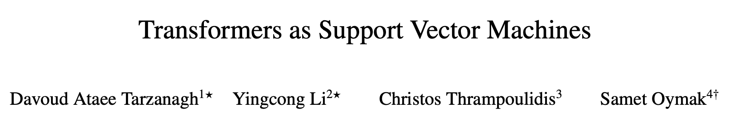
Connections to Support Vector Machines
SVMs were all the rage in the late 90s and early 2000s
Neural networks had been a “dead end” since early 90s
1-layer self-attention Transformers = hard-margin SVM
Multilayer transformers = hierarchy of SVMs

Slide 13

Let’s add some pictures
Courtesy of The Illustrated Transformer

Slide 14

Notes:
“Encoder” of the previous slide is a series of encoders, where each step self-attends to all outputs of the previous step.
The output of the final encoder is sent to all the decoding layers.
Each decoder can self-attend to all decoded outputs UP TO the current position (not beyond it).
Each decoder can also attend to all encoded inputs.

Slide 15
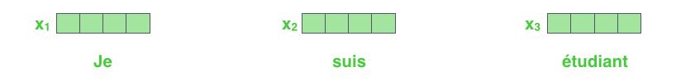
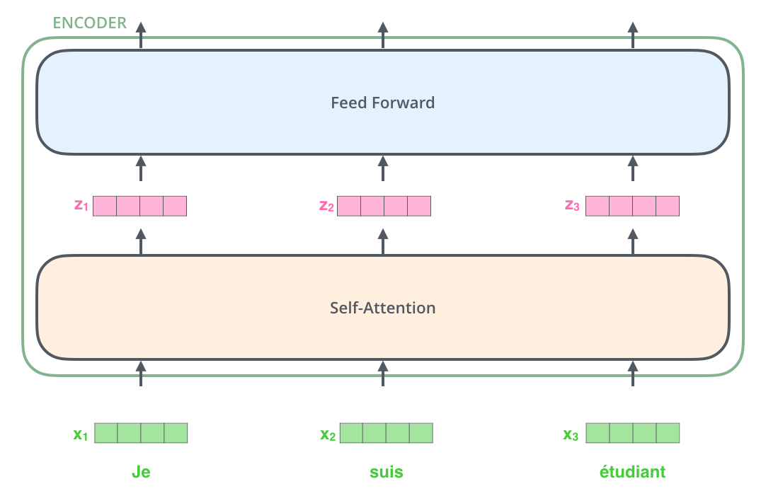
Notes:
One single encoding block: a self-attention layer, followed by a fully connected feed forward layer.
Embeddings of size 512 (at least according to the 2017 paper)

Slide 16

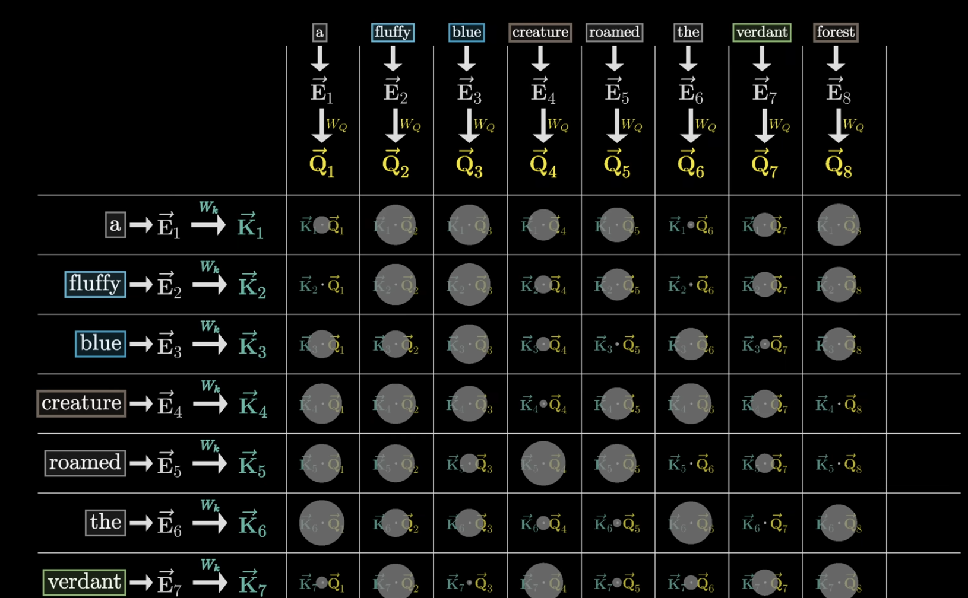
Notes:
Multiplying x1 by Wq gives q1, and x2 by Wq gives q2
- think of these query vectors projections of the embedding onto the “question” space
Also multiply each x by Wk, to give each key vector
- think of key vectors as potentially answering the queries in the “question” space
If keys roughly match queries, they “align” with each other—meaning they “attend to” each other
For each word in the sequence, we need to compute a “score”—how relevant that word is, relative to the other words.
For self-attention of word 1, that’s q1 times k1 (self-attention). For its attention against word 2, that’s q1 times k2.
Wq, Wk, and Wv are all learnable / tunable parameters in the network; for our purposes, you can imagine these “simply exist” or are otherwise learned automatically according to backpropagation
Each value vector is again, found by multiplying the x vectors against the Wv matrix
- The output of the dot product of key * value is multiplied against the value vector, and acts as a weighting to add to the original embedding

Slide 17
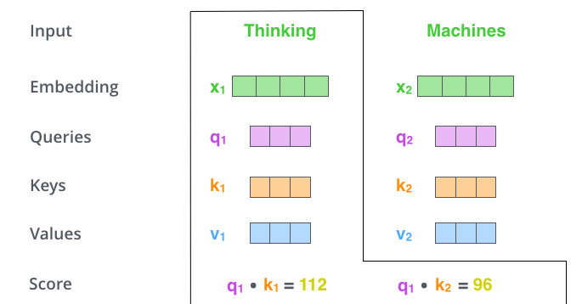

Slide 18
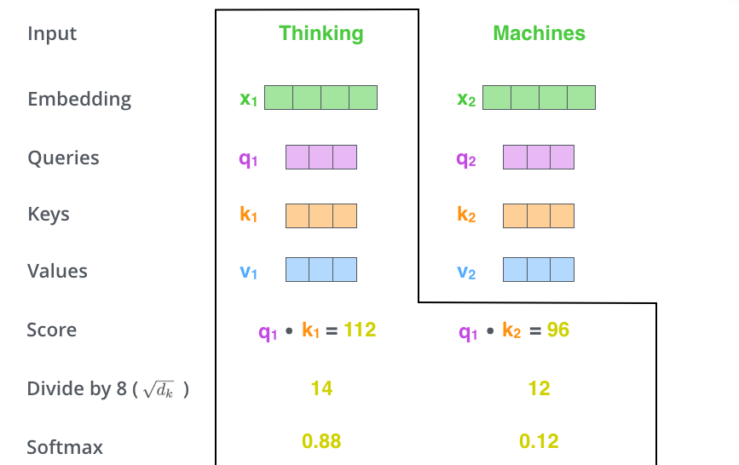

Slide 19

Notes:
Multiply values by softmax, then sum them up. This produces self-attention values for this layer at this position (the first word).

Slide 20
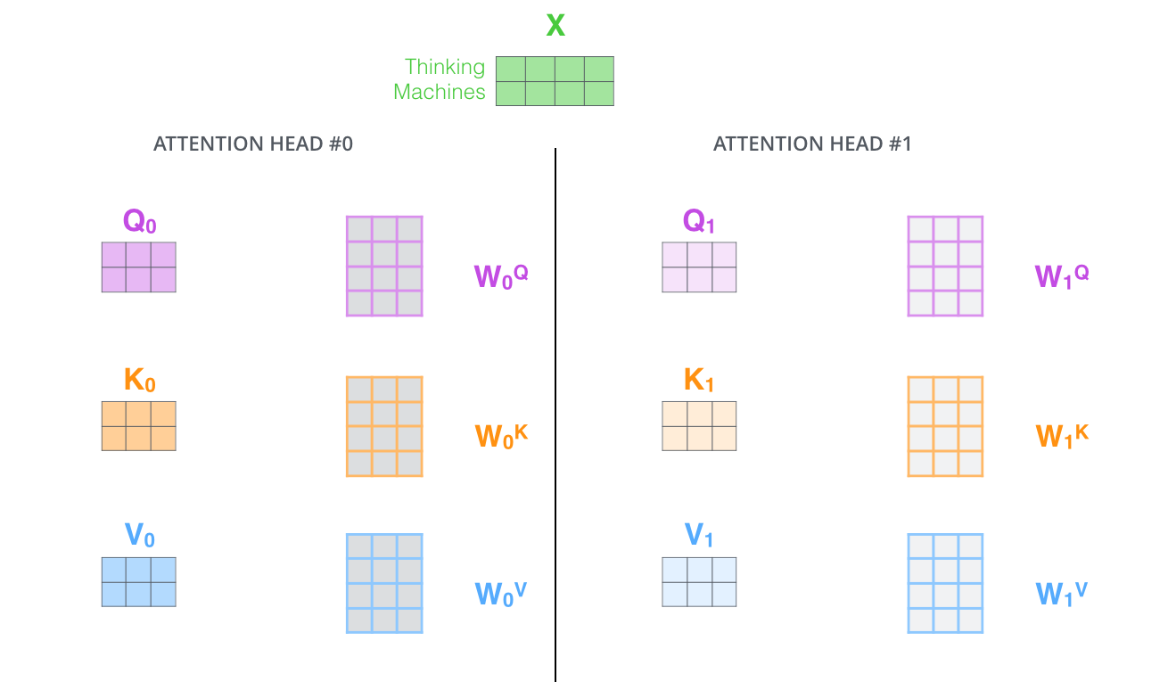
Notes:
Multi-headed attention uses several “representation subspaces”, allowing the model to focus on multiple parts of the input at once and in parallel.
Also, the operations here have been put into their matrix forms, which is how they’re actually computed in practice (so the vector operations of self-attention can also be parallelized).

Slide 21
What about the decoder?
Final K, V from encoder sent to each decoder
Each decoder focuses its attention on “correct” positions of encoder
Notes:
In the decoder, the self-attention layer is only allowed to attend to earlier positions in the output sequence.
Works just like multiheaded self-attention, except it creates its Queries matrix from the layer below it, and takes the Keys and Values matrix from the output of the encoder stack.

Slide 22
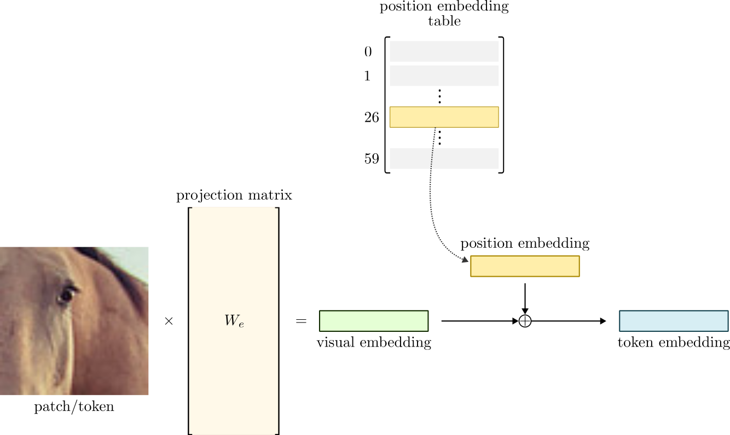
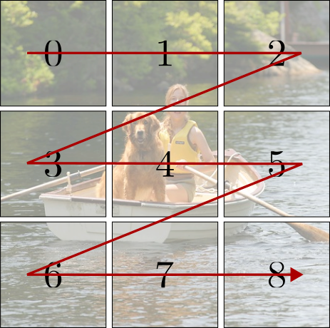
Vision Transformers (ViT)
Built on the same principles
Patches = tokens
Still have positional encodings
Are still embedded in the first encoder step
Attention = dictionary lookup
dictionary[query] = value
If key==query, return value
“Soft” selection
Everything else is the same!

Slide 23
Transformer limitation
Attention mechanism is still O(n²)
Each token compared to each other token
Subquadratic methods exist but rely on low-rank / sparse approximations, and require dense Attention layers
Ultimately limits the possible sequence length n (context window)

Slide 24
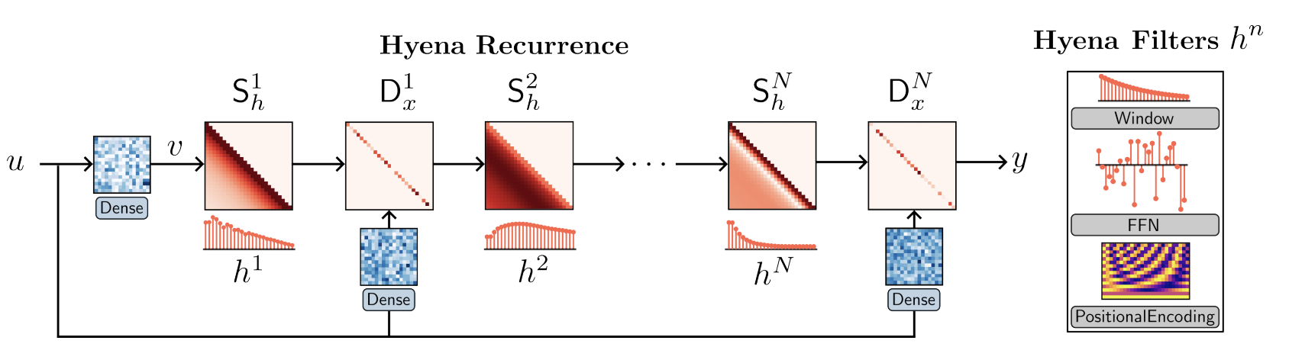
Hyena
Subquadratic drop-in Attention replacement
Hyena operator
Long convolutions
filter sizes as long as the input
Data-controlled gating (element-wise multiplication)
Convolutions in FFT (i.e., frequency) space are element-wise multiplications!
Notes:
The Hyena operator is defined as a recurrence of two efficient subquadratic primitives: an implicit long convolution h (i.e. Hyena filters parameterized by a feed-forward network) and multiplicative elementwise gating of the (projected) input. A specified depth (i.e., number of steps) of the recurrence controls the size of the operator. For short recurrences, existing models are recovered as special cases.
Hyena can equivalently be expressed as a multiplication with data-controlled (conditioned by the input u) diagonal matrices Dx and Toeplitz matrices Sh.
(Toeplitz matrices have main diagonals comprised of a single value, reducing the number of unique entries in the matrix and ultimately in a system of equations that is, on average, easier to solve than an arbitrary one; e.g., they can be diagonalized in O(n^2), whereas traditional SVD is O(n^3).)
Hyena exhibits sublinear parameter scaling (in sequence length) and unrestricted context, similar to attention, while having lower time complexity.

Slide 25



Slide 26
Conclusions
Transformer architecture for modeling sequences (of text or images)
Throws out recurrences of RNNs for more parallel training
Ditching recurrences also allows for arbitrary context windows
Still use the encoder-decoder architecture
Input embeddings are critical to the overall performance
Attention
Transformer allows for all tokens to “attend” to all other tokens
Can model extremely long-distance dependencies (spatially or sequentially)
Only drawback is quadratic computation time
Hyena operator
Clever use of FFT-based convolutions and Toeplitz matrices to accelerate standard computations and produce subquadratic performance

Slide 27
References
“Attention is All You Need”, https://arxiv.org/abs/1406.6909
Mechanics of seq2seq with Attention https://jalammar.github.io/visualizing-neural-machine-translation-mechanics-of-seq2seq-models-with-attention/
The Illustrated Transformer https://jalammar.github.io/illustrated-transformer/
An Intuitive Introduction to the Vision Transformer https://sthalles.github.io/an-intuitive-introduction-to-the-vision-transformer/
Transformers as support vector machines. https://arxiv.org/pdf/2308.16898.pdf
Hyena Hierarchy: Towards Larger Convolutional Language Models https://arxiv.org/abs/2302.10866
3Blue1Brown: Transformers: How LLMs work, explained visually https://www.youtube.com/watch?v=wjZofJX0v4M
3Blue1Brown: Attention in Transformers, step-by-step https://www.youtube.com/watch?v=eMlx5fFNoYc

Slide 28
Up next
Final Project Update #2 is due TONIGHT!
Homework 5 is due next Tuesday! (April 15)
Next Tuesday & Thursday (April 15 & 17): last lectures of the class
April 22, 23, and 24: Final Project Presentations
If you have given me a preference for presentation day, yay!
If you have not, your time will be randomized & determined each day!
Presentations are 20 minutes, with 2-3 minutes for questions
Please come support your classmates even after you have presented

